Slide 1
Understanding Ionization Efficiency from Sub-keV Nuclear Recoil Events in Direct Detection Dark Matter Experiments
Mitchell Matheny
University of Colorado Denver

Slide 2
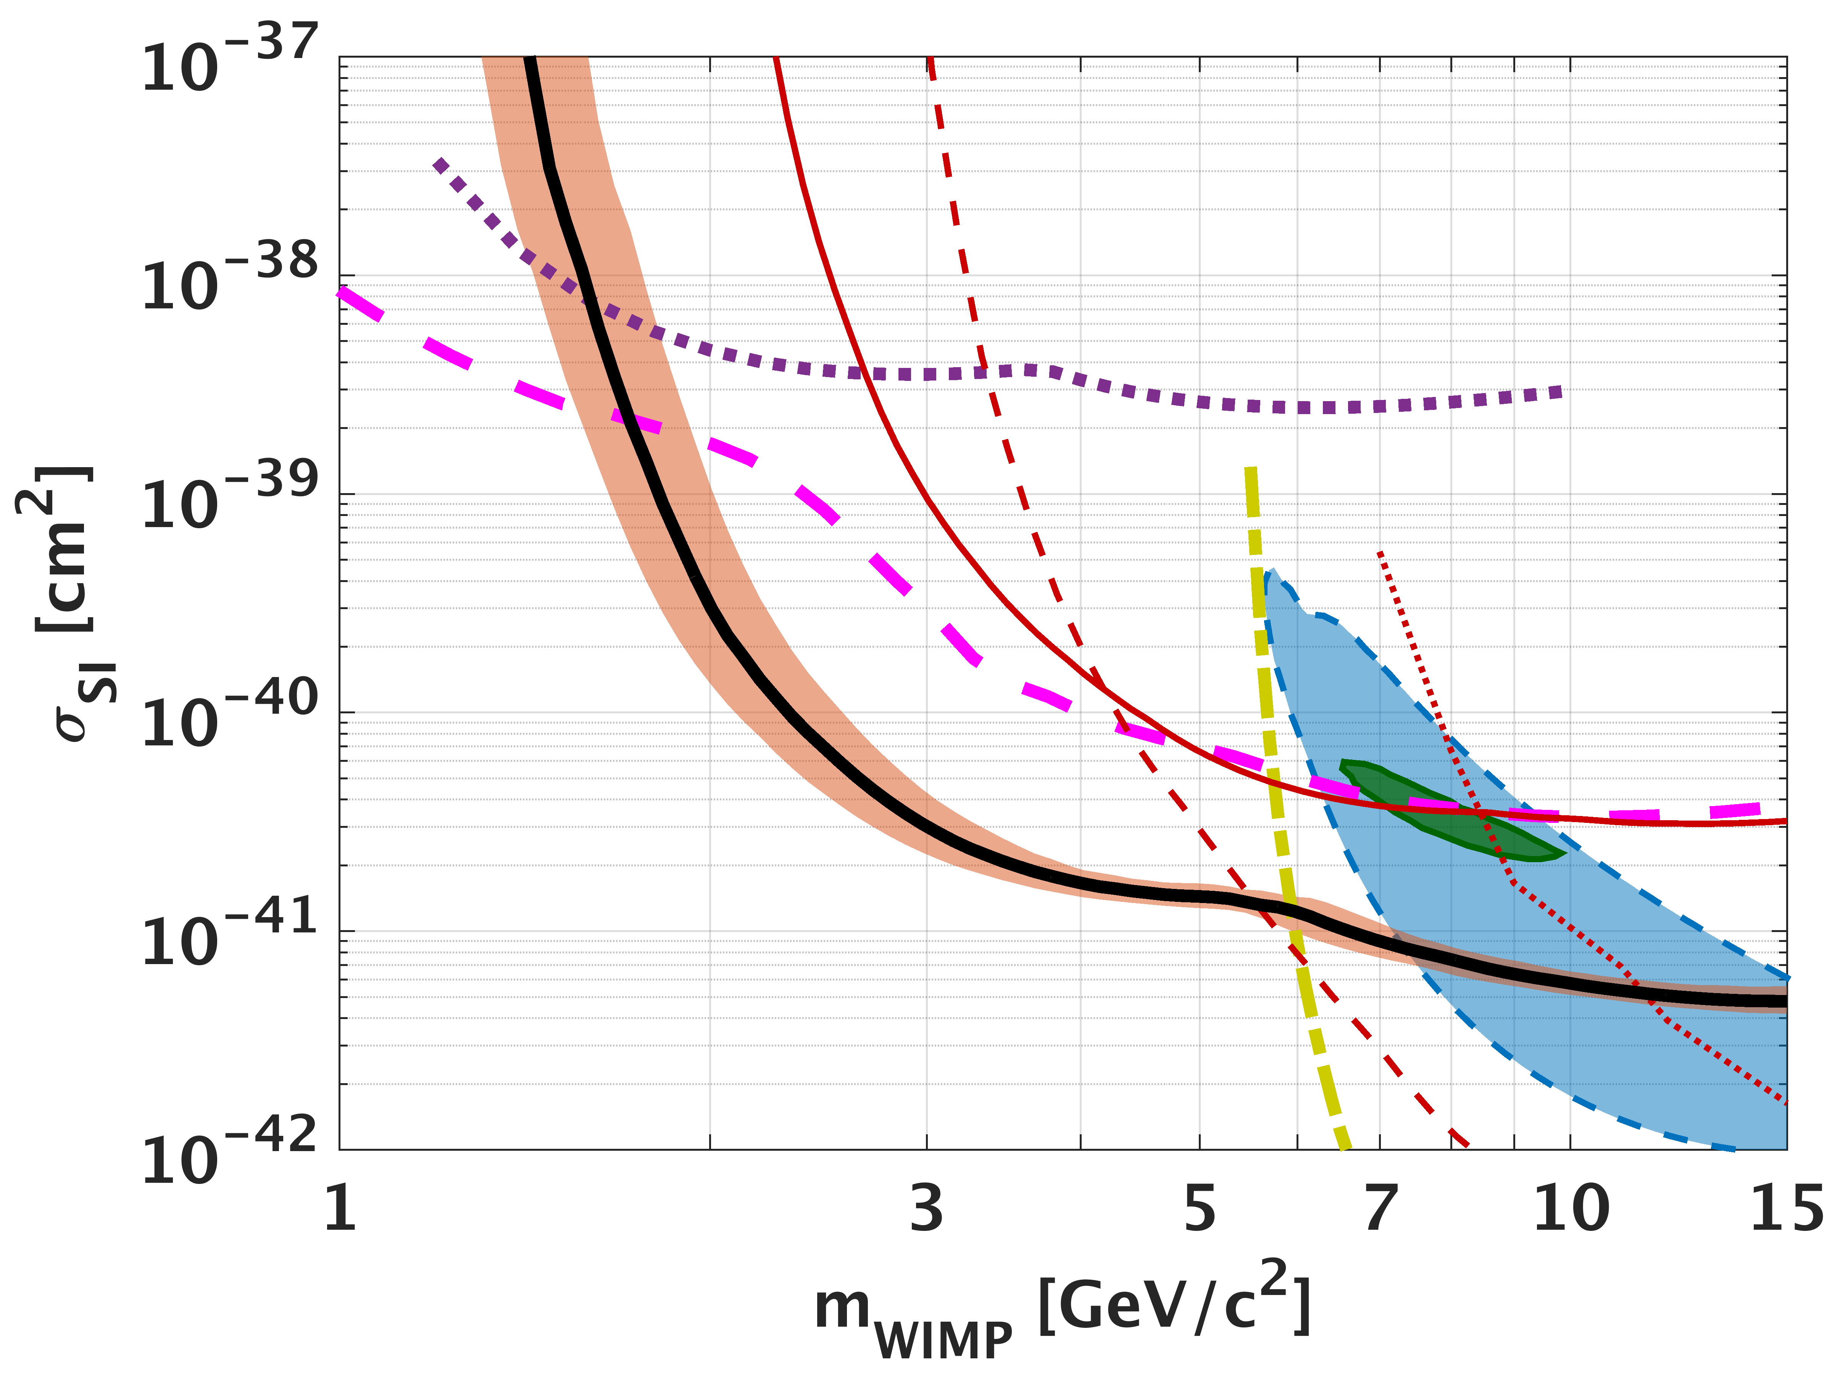
Dark Matter
Dark matter has been theorized to be Weakly Interact Massive Particles(WIMPs) with masses on the order of a GeV/c² to a few TeV/c^{2.}
In the post Minimal Supersymmetric Standard Model era, we are completely in the dark on the dark matter mass.
Dark matter can still be ”WIMP” like in the way it interacts with nuclei, but can have a very low mass.
Detectors that can measure electron-hole pairs have been moving the DM mass limit plot down.
Notes:
CDMSlite phonon energy only.
We only know how to calibrate to Electron equivalent recoils, in order to determine the true nuclear recoil energy we need information about the ionization eff (yield)

Slide 3
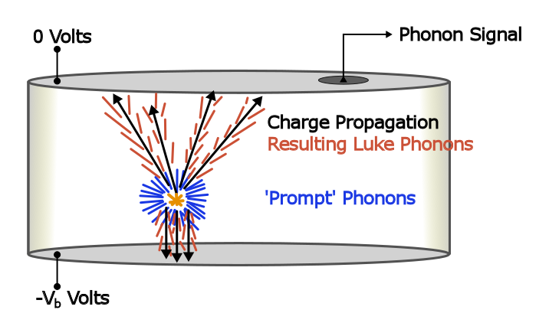
Charge Creation in Solids
When a WIMP hits nuclei initial phonons are produced and charge is liberated.
Current generation of low threshold detectors only count number of charge carriers produced.
There is no good nuclear recoil calibration standard.
Need to know ratio of energy that goes into the electronic system and its variation.
Or the best we could hope for is a distribution of the number of electron hole pairs for a given E_{r}
Notes:
A WIMP comes in a hits the nuclei, initial phonons are produced and charge is liberated in some ratio. Current generation of lowest threshold detectors only count the number of produced electron hole pairs. We do not have a good nuclear recoil calibration standard. Therefore to extract the nuclear recoil energy we have to know the ratio of recoil energy that goes into the electronic system.
Variation in energy given to the electronic system exists because a single E_r can create a spectrum of a possible number of electron hole pairs

Slide 4
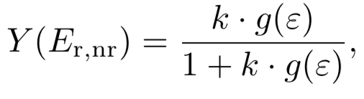

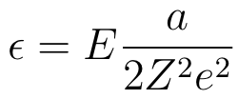
Ionization Efficiency (Yield)
ratio of energy used to create electron-hole pairs to the energy used to create phonons
For CDMSlite, this is not something that can be directly measured and must be modeled using Lindhard.
Notes:
There is a variant number of electron hole pairs exists for a given Er for both electron recoils and nuclear recoils.

Slide 5
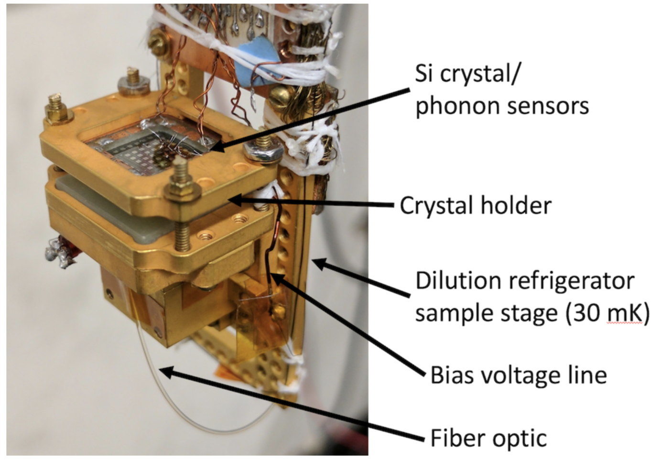
HVeV Detector.
Biased with ~100 V/cm
Phonon signal read out with QETs
resolution of ∼0.09 e−h+ Biased

Slide 6
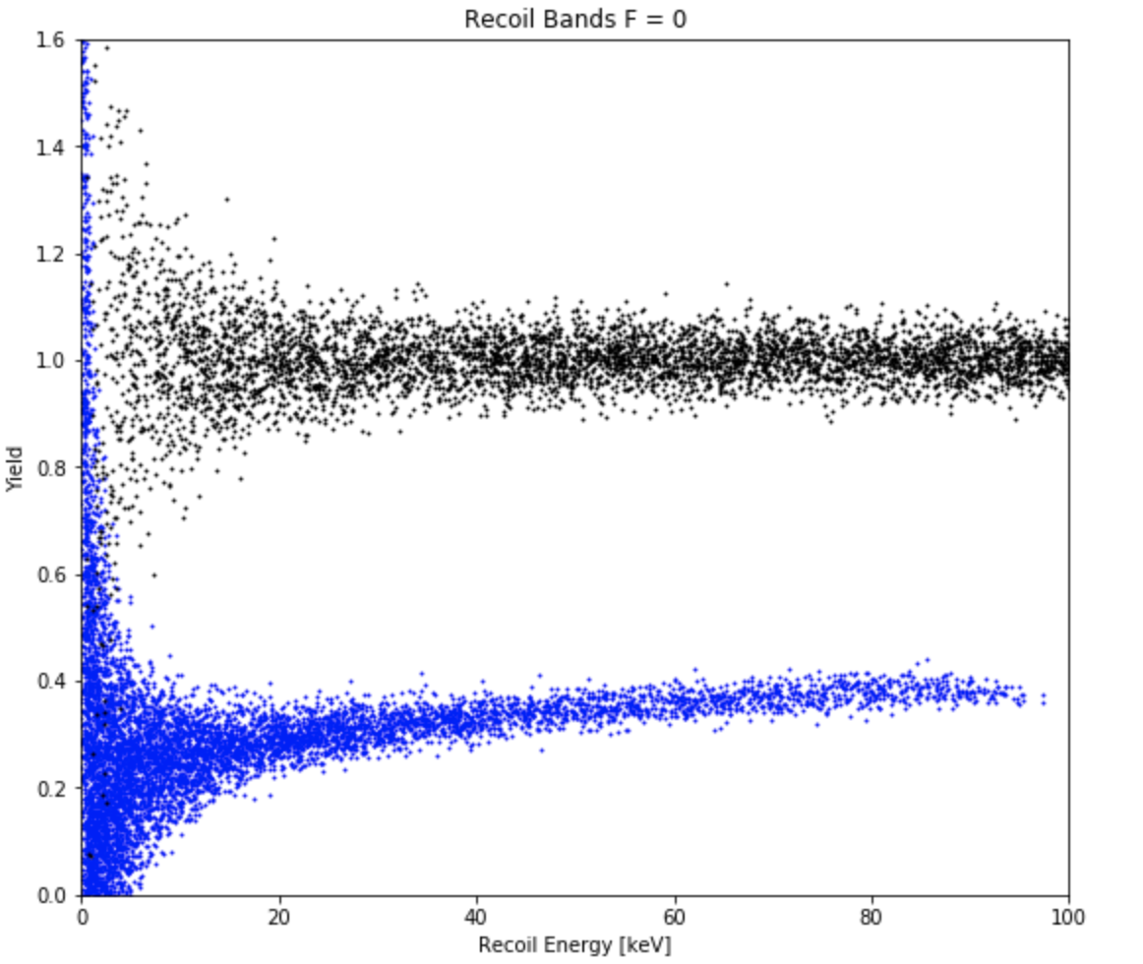
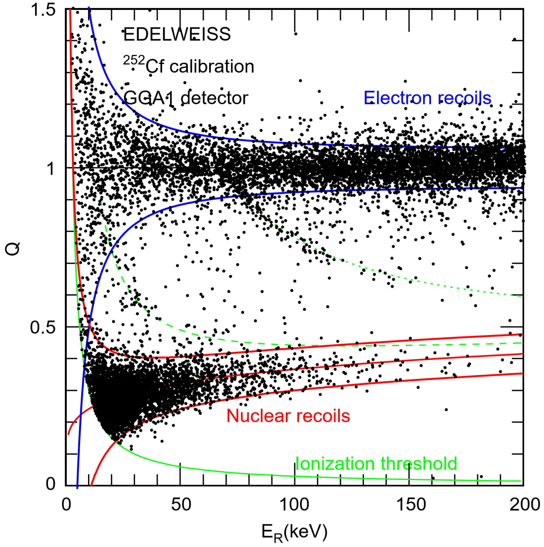
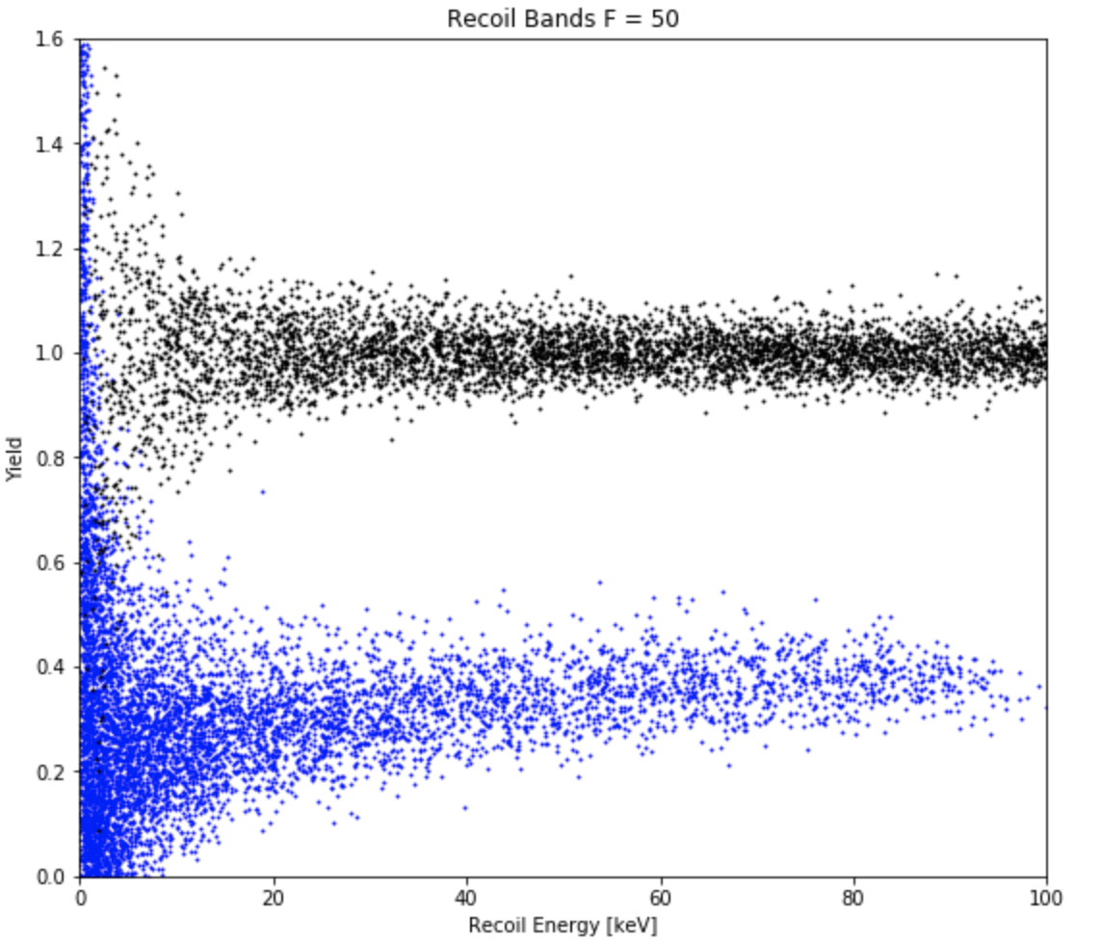
Notes:
Bands from data -> simulated bands. Side by side.

Slide 7
END
Notes:
Bands from data -> simulated bands. Side by side.

Slide 8
CDMSlite Detector
Low threshold ionization experiment
Applied Voltage ~50-80 V/cm
Ionization energy resolution of 170 eVee
Detects phonons only.
Phonon amplification via Neganov-Trofimov-Luke (NTL) effect
Notes:
A WIMP comes in a hits the nuclei, initial phonons are produced and charge is liberated in some ratio. Current generation of lowest threshold detectors only count the number of produced electron hole pairs. We do not have a good nuclear recoil calibration standard. Therefore to extract the nuclear recoil energy we have to know the ratio of recoil energy that goes into the electronic system.
An important class

Slide 9



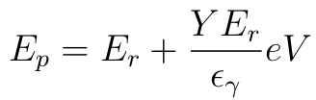
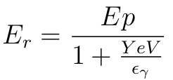
Recoil Energy Reconstruction CDMSlite
CDMSlite measures phonon energy (E_{p}) only.
Recoil energy is reconstructed using total phonon energy E_{p} and the contribution from Phonon amplification via Neganov-Trofimov-Luke effect E_{Luke}

Slide 10
Ionization Efficiency (Yield)
ratio of energy used to create electron-hole pairs to the energy used to create phonons
For CDMSlite, this is not something that can be directly measured and must be modeled using Lindhard.

Slide 11
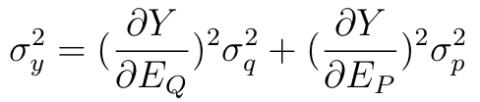
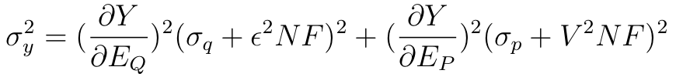
Yield Variance
The yield variance exists due to fact that for a given energy, nuclear recoils don’t produce the same amount of e-h pairs
This is not accounted for in current experiments.
This variation may be significant with new experiments with resolutions as low as 1 electron hole pair.

Slide 12
Motivation: Single Electron –Hole Resolution
PLOT SHOWING PHONON SPECTRUM AND Neh

Slide 13
Current Work
Four plots showing difference between simulated bands with and without added variance. .. And data.

